Slide 1
Show Me The Money!
Uncovering The True Cost Of A Breach
Inga Goddijn, EVP
Risk Based Security, Inc
Becky Swanson, Managing Director
Markel

Slide 2
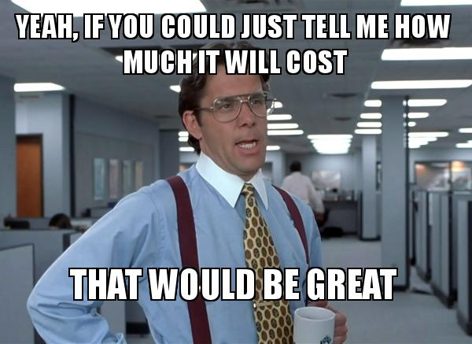
Today’s Session
Strategies for answering the security breach cost question
What sources are available
Which can we trust
How can we tackle the question ourselves
Wildcard factors that increase cost

Slide 3

Why It’s Worthwhile
Justify Security Investment
Communication! Getting everyone on the same page on the range of outcomes

Slide 4

Cost of Data Breach Study: Global Analysis
Pros:
One of the most widely citied studies
Actively researching costs since 2002
Free* to access full report
Cons:
Cost per record?
Data breaches, sure! But what about other events?
Produced annually
Survey of ~350 companies experiencing a breach event
Spanning ~11 countries
2015 Findings:
Avg Cost: $3.79M
Avg Cost per Record: $154
Find it here: www-03.ibm.com/security/data-breach/

Slide 5

Cyber Claims Study (& 2015 DBIR)
Pros
Gathers actual payouts, not estimated
Interesting stats showing how the money is spent
Cons
Insurance proceeds – and only what had been paid to date over and above of retention
Verizon estimate, with the same data - $0.58 cents per record… or put another way
A breach of 1,000 records could cost anywhere from $3,110 to $1,461,730
Produced annually
Survey of ~160 cyber insurance claim payments
2015 Findings
Typical payouts ranged from $30,000 to $263,000
Median cost per record: $13.00
Average cost per record: $964.31
Find it here: netdiligence.com/downloads/NetDiligence_2015_Cyber_Claims_Study_093015.pdf

Slide 6

Calculating Market Impact - Academic Studies Galore!
Pros
Evidence based
Capture larger impact to the organization as a whole
Cons
Mixed outcomes
Limited sample – only public companies
Limited to publicly disclosed events
“Breach fatigue” – That’s just a part of doing business today
“Effect of Internet Security Breach Announcements on Market Value: Capital Market Reactions for Breached Firms and Internet Security Developers”
“Is There A Cost To Privacy Breaches? An Event Study”
“Assessing the Impact of a Privacy Breach on a Firm’s Market Value”
Google it here: economic impact of security breaches on market value

Slide 7
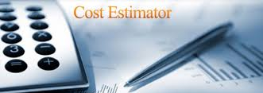
Cost Calculators and Risk Estimation Tools
Pros
Can be quick and easy
Or the opposite, very thorough
Cons
Freebies tend to be overly simplistic
Or built on known studies
Services incur a cost for subscribing
Variety of approaches, some quite complex
Many simplified, free tools and some subscription based services too
Google it here: data breach cost calculator

Slide 8

Why Is This So Difficult?
Different companies, different costs
Not a lot of incentive to share information

Slide 9


Why Is This So Difficult?
Costs become ‘absorbed’ into operations over time (especially when drawn out over a number of months or even years)
Quantifying damage from intangibles (trade secret, know-how, not to mention loss of customer confidence, brand damage and staff turnover) is highly subjective

Slide 10

Why Is This So Difficult?
Lack of a meaningful methodology or framework for calculating IMPACT
We Can Build It!

Slide 11

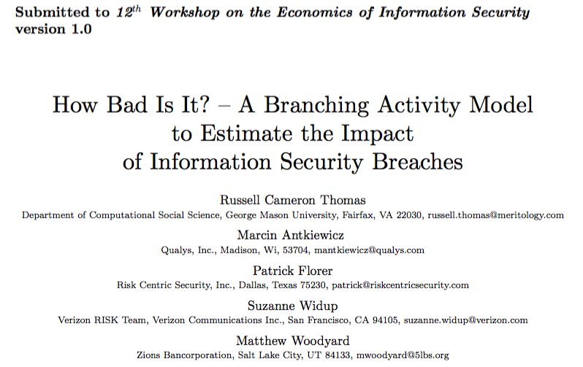
Show Me The Money!

Slide 12
The case for “Cost of Recovery and Restoration”
Use cost estimates that are specific to our business
Can be tied to observable, identifiable events
Allows for experimenting with different scenarios
Map to transfer options such as insurance, contractual obligations
Broaden conversation from monetary cost to business impact

Slide 13
Identifying Impact
Respond
Clean up
Replacement
Diversion
Time
Resources
Consequences
Legal
Fines, Penalties
“Indicator of Impact” = an observable event, behavior, action, change or communication indicating an attempt to respond, recover, restore, rebuild or reposition as a result of harm.
How Bad Is It? Thomas et al 2013

Slide 14
How Would This Work?
Establish a cost estimate method for impact*
As scenario unfolds, track the impact points
Tally the costs from each impact point
Results Worth Discussing!
Get creative! Develop an event scenario to test
Capture “Indicators of Impact”

Slide 15
Show Me The Impact!
Response/Recovery
Asset Impairment
Time, Resources, Expenses Incurred Above and Beyond Normal Operations
Additional time to mitigate
Forensic investigation
Reporting to external organizations
Services to impacted persons
Identifiable damage to an information asset or outright fraud
Ransom, embezzlement
Clean, repair the asset
Replace the asset(s)

Slide 16
Show Me The Impact!
Business Interruption
Extraordinary Expenses
Disruption to operations
Downtime
Contractual penalties from delays or cancelations
Lost sales from interruption
Replace vendors or staff
Unexpected expenses
Cost of legal counsel
Additional audit or compliance costs
Cost of unexpected upgrades
Fines or penalties

Slide 17
Equating Impact to Cost
“Impact” can be measured
Time Spent
Resources Diverted
Unexpected Expenses

Slide 18
Show Me The Math!
Legal Response
Lost Sales from Interruptions
Some Examples
In-house counsel
Can be reflected as Number of staff hours required x hourly wage cost = amount of operating overhead diverted to the response
Hired Guns
Hourly rate x anticipated hours = legal fees (Insurable!)
Formulas Abound!
BI = T x Q x V
BI = Business Interruption
T = Time of disruption (hours, days, etc)
Q = Quantity of goods normally produced or sold per unit of time in T
V = the value of each unit (i.e. profit from Q)

Slide 19




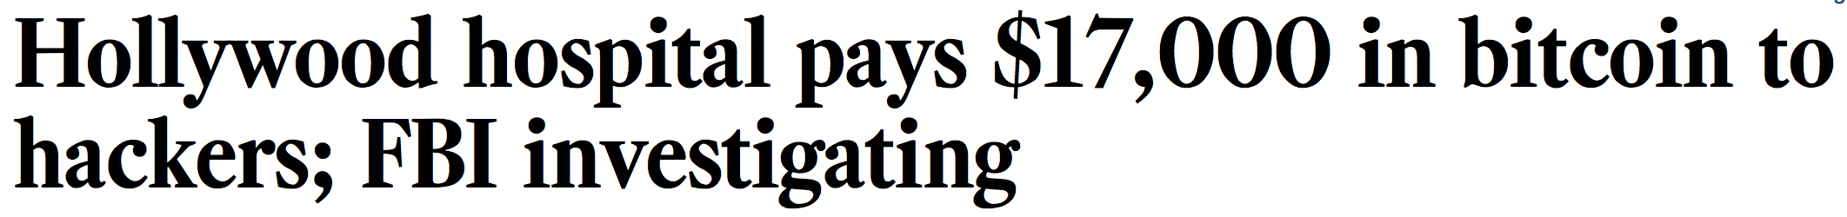
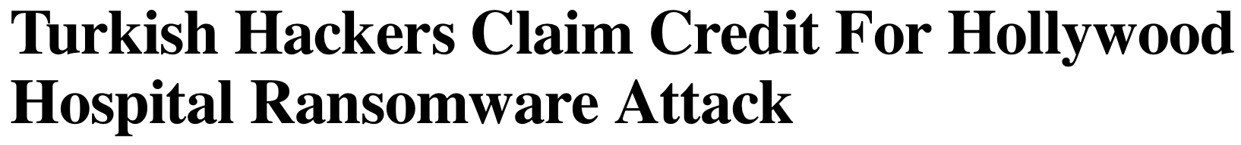
Show Me An Example
Notes:
Paid $17,000 ransom (paid in bitcoin)
Started Friday, 2/5 – disrupted communications (although, seems issues were detected prior to the 5th with some systems “locked up” for at least a week prior to 2/5)
Forced the use of pen and paper for record keeping
Quickest path to recovery and restoring operations – pay the ransom
Regained control by Monday, 2/8
CEO communicating with the press
Reporting to the FBI
“No impact on patient care or medical records” BUT – some patients were diverted to other hospitals, upset they had to wait for results or travel to distant facilities to get services.

Slide 20
Show Me An Example!
Hollywood Presbyterian Medical Center
Malware Detected
Systems taken off-line
Clean up
Patients Diverted
Lost Revenue
$17,000 Ransom
FBI Investigation
CEO & The Press
Manual Records
Communication
Convert to EMR

Slide 21
Applying The Math
Technical Response
Additional time (Staff hours spend x cost per hour)
Asset restoration (Service provider fee for remediation assistance)
Records recreation (In house or Contract for converting manual documents)
Patient Services
Lost Revenue from diversion (Business interruption)
Resources devoted to communication (Staff hours spent x cost per hour)
Ransom
$17,000 payment
Reporting and coordination with FBI investigation (Staff hours x cost per hour)
CEO / leadership diversion
Time spent communicating with the press (Hours x cost per hour)

Slide 22

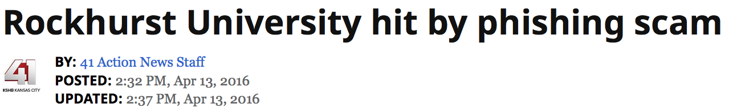
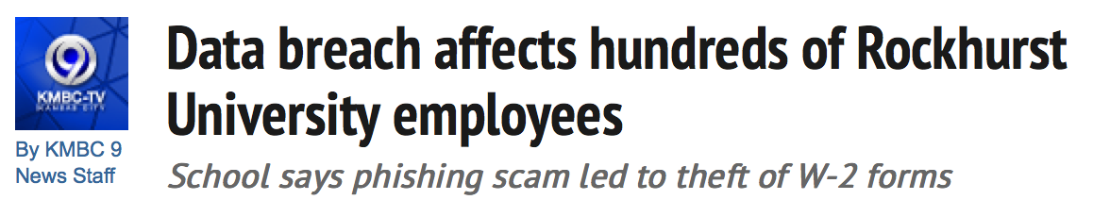

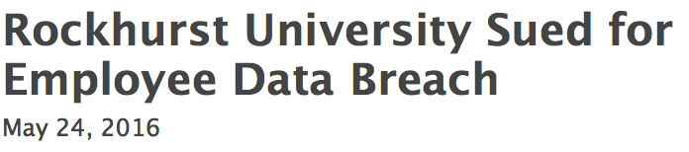
Show Me Another Example!
Notes:
April 4th (Monday morning) Employee received an email from someone ‘impersonating a university administrator”, requesting W-2 information. Hard working and conscientious employee jumped on it and promptly replied with the 2015 W-2s of approximately 1,300 staff members.
Incident discovered 2 days later, on June 6th.
Details leaked included names, addresses, SSN’s.
April 11th, school president announces the breach to staff
Offered 2 years of identity protection through AllClearID
Held staff meetings on April 14th and 15th
IRS, local law enforcement and the FBI notified
No reported losses incurred by employees, YET
May 19th, proposed class action lawsuit filed, alleging “flagrant disregard” for the employees’ rights to privacy and that the university has caused their employees harm “by failing to establish and implement appropriate administrative safeguards to protect their information”

Slide 23
Show Me An Example!
Rockhurst University
Phished!!
Confirmation
IRS, Law Enforcement
Identity Protection
Lawsuit!
Staff Communication
Awareness Training
Letters
Meetings

Slide 24
Applying The Math
Technical Response
Additional Staff Training (Staff hours spent x cost per hour and/or phishing exercises)
Coordination with outside agencies
General Counsel (Staff hours spent x cost per hour)
Communication
Notification (drafting, printing and mailing costs)
Staff meetings (Hours spent)
Identity Remediation
2 years of credit monitoring (subscription cost)
Proposed Class Action Lawsuit
Legal fees for defense
Possible settlement

Slide 25
You Paid How Much For That?!?
Looking for impact can identify some interesting trends
Why did it take a nearly a week for HPMS to declare a “state of emergency”?
Where were the back-ups in all of this?
Is it usual procedure at Rockhurst to send large amounts of sensitive data via email?
What was missing from the awareness training program at Rockhurst?

Slide 26
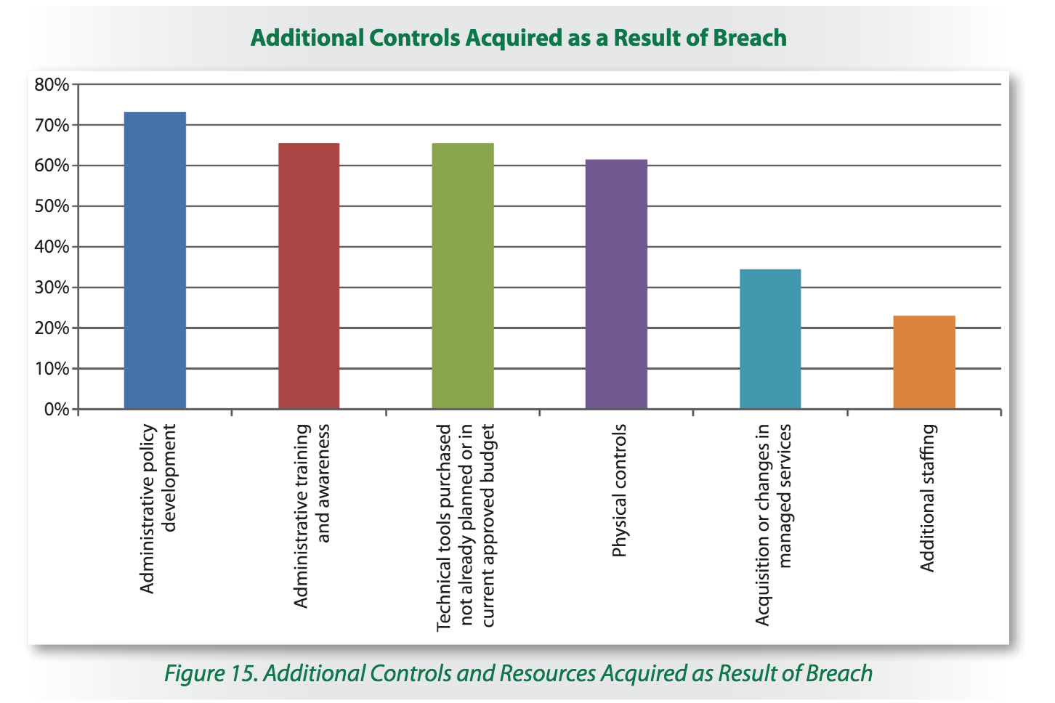
Show Me The Money
SANS Institute, Cleaning Up After A Breach Post-Breach Impact: A Cost Compendium, Barbara Filkins with contribution by Kevin Fogarty December 2015

Slide 27

Show Me The Money
TalkTalk Incident
Rubbing Salt Into The Breach Wound

Slide 28

Show Me The Money
TalkTalk Breach
October 22, 2015
156,959 customer names, addresses, email addresses and phone numbers, as well as 28,000 partially obscured credit or debit card details, 15,656 bank account numbers with sort codes, and 15,000 dates of birth “possibly” compromised in a ‘significant and sustained’ attack on website

Slide 29
Show Me The Money
TalkTalk
Customers
"Potentially it could affect all of our customers, which is why we are contacting them all by email and we will also write to them as well.”
"It's too early to know exactly what data has been attacked and what has been stolen”
"Unfortunately cybercrime is the crime of our generation. Can our defences be stronger? Absolutely. Can every company's defences be stronger? I'm a customer myself of Talk Talk, I've been a victim of this attack."
"I have not received a single piece of correspondence. The level of information is lacking. And to think this is Get Safe Online Week!”
"TalkTalk's online advice is not proportionate to what has happened. Telling customers to "keep an eye on accounts" just does not cut it in terms of advice.”
"They may not get a payment for my next bill if they don't get this sorted,"
BBC: TalkTalk cyber-attack: Website hit by ‘significant’ breach October 23, 2015
Notes:
Customer confidence was already shaken:
12/2014 – TalkTalk customer data was apparently being used by India-based scammers, that had somehow obtained customer names, phone numbers and TalkTalk account numbers.
8/2015 - Carphone Warehouse incident, personal info as well as credit card data nicked from websites providing services to TalkTalk mobile customers
8/2015 – TalkTalk website was found to be serving up malware infected advertisments.
Follow-on events in January. In the course of conducting a security review, discovered that 3 employees at a call center in India – run by a local business Wipro – had been pilfering TalkTalk customer data.

Slide 30
£60M & Counting
£60 million spent on
Forensic & Security Reviews
New controls & security features
Re-evaulation of vendor partners
Free upgrades available for ALL customers
Extra TV channels, unlimited landline, and more!
Lost at least 100K customers, perhaps as many as 250K
Gained fewer new customers than forecast thanks to shut-down in on-line sales operations
Multiple incentives to regain customers including free upgrade, taken up by 489K customers

Slide 31

Show Me The Money
Capturing and quantifying impact can both answer the question of “how much will this cost us” as well as illustrate the value of investing in controls today

Slide 32


